Slide 1
Shop Floor Control System
SFC to EDI
2006/08

Slide 2
Contents
  Out-861 RC (收料)
  Out-867 PT (入庫)
  Out-856 Shipping (出貨)
  ENVELOPE

Slide 3
Out-861 RC (RC)
EDI
scan carton
PUSH TITLE
b2b.RC_CARTON
b2b.RC_CARTON@sfc2edi
b2b.RC_PALLET
b2b.RC_PALLET@sfc2edi
DOC_ID: STXRC+YWW+xxxxxxx
…
…
SEQ_ID:
➔
MOVE_FLAG
→N (Y表示即將搬到ERP)
RECORD_STATUS
→1表示送到EDI, EDI回覆0
b2b.RC_HEADER
b2b.RC_HEADER@sfc2edi
Job (5 min)
SAJET.SFC2EDI_RECEIVE
DOC_ID: STXRC+YWW+xxxxxxx
…
DIRECTION: ➔ OUT
B2B_MSG_TYPE→ 861
DATASOURCE→ EDI
TRANS_FLAG→ N
b2b.ENVELOPE

Slide 4
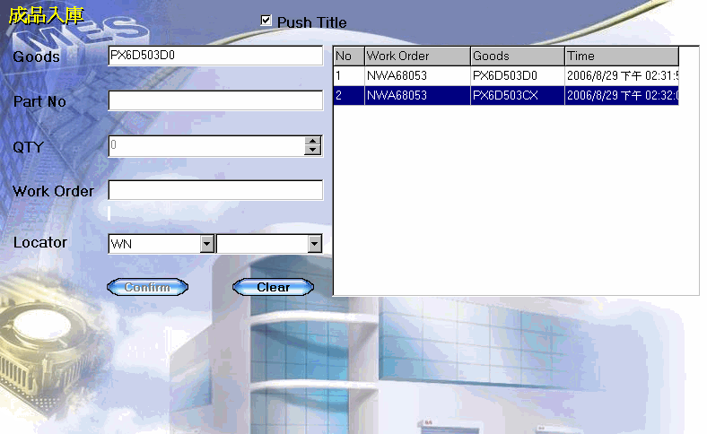
Out-867 PT (PT)
完工入庫
PUSH TITLE
procedure
MES_ERP_WIP_DELIVER
b2b.ENVELOPE
DOC_ID: STXPT+YWW+xxxxxxx
…
DIRECTION: ➔ OUT
B2B_MSG_TYPE→ 867
DATASOURCE→ EDI
TRANS_FLAG→ N
b2b.PT_SERIAL
b2b.PT_ITEMS
DOC_ID: STXPT+YWW+xxxxxxx
…
…
SEQ_ID:
➔
MOVE_FLAG
→N (Y表示即將搬到ERP)
RECORD_STATUS
→1表示送到EDI, EDI回覆0
b2b.PT_HEADER
Job (5 min)
SFC2EDI_DELIVER
b2b.RC_CARTON@sfc2edi
b2b.RC_PALLET@sfc2edi
b2b.RC_HEADER@sfc2edi

Slide 5
Out-856 Shipping (SH)
Ship-Confirm
PUSH TITLE
procedure
SJ_SHIPPING_CONFIRM
b2b.ENVELOPE
DOC_ID: STXSH+DN
…
DIRECTION: ➔ OUT
B2B_MSG_TYPE→ 867
DATASOURCE→ EDI
TRANS_FLAG→ N
DOC_ID: STXPT+DN
…
…
SEQ_ID:
➔
MOVE_FLAG
→N (Y表示即將搬到ERP)
RECORD_STATUS
→1表示送到EDI, EDI回覆0
b2b.ASN_OUT_SERIAL
b2b.ASN_OUT_ITEMS
b2b.ASN_OUT_CARTON
b2b.ASN_OUT_PALLET
b2b.ASN_OUT_HEADER
b2b.ASN_OUT_SERIAL@sfc2edi
Job (5 min)
SFC2EDI_DN
b2b.ASN_OUT_ITEMS@sfc2edi
b2b.ASN_OUT_CARTON@sfc2edi
b2b.ASN_OUT_PALLET@sfc2edi
b2b.ASN_OUT_HEADER@sfc2edi

Slide 6
ENVELOPE
b2b.ENVELOPE
Job (5 min)
SFC2EDI_DOC
b2b.ENVELOPE@sfc2edi

